Slide 1

Android Training
Notes:
Module 01:Activities

Slide 2


TOPICS
What are Fragments?
Fragment Lifecycle
Advantages of using Fragments
Classes that work with Fragments
Adding Fragments
Communication between Fragments

Slide 3
What is a Fragment?

Slide 4
What is a Fragment?
May & June 2012 Recruiting Plan
A Fragment is a piece of an application's user interface or behavior that can be placed in an Activity which enable more modular activity design.
It will not be wrong if we say, a fragment is a kind of sub-acitivity. Following are important points about fragment.
A fragment has its own layout and its own behavior with its own lifecycle callbacks.
You can add or remove fragments in an activity while the activity is running.
You can combine multiple fragments in a single activity to build a multi-pane UI.
Recruit 70 “Best Fit” Consulting Employees
Build out a Marketing team dedicated to recruiting
Formalize training program for new recruiters
Build out fully functioning offshore recruiting team
Implement call quality feedback loops
Coach and Mentor recruiters
Improve daily efficiency for recruiting team
© 2014 Unbounded Solutions
4

Slide 5
What is a Fragment?
May & June 2012 Recruiting Plan
Fragment life cycle is closely related to the lifecycle of its host activity which means when the activity is paused, all the fragments available in the acivity will also be stopped.
A fragment can implement a behavior that has no user interface component.
Fragments were added to the Android API in Honeycomb version of Android which API version 11.
A fragment can be used in multiple activities.
Recruit 70 “Best Fit” Consulting Employees
Build out a Marketing team dedicated to recruiting
Formalize training program for new recruiters
Build out fully functioning offshore recruiting team
Implement call quality feedback loops
Coach and Mentor recruiters
Improve daily efficiency for recruiting team
© 2014 Unbounded Solutions
5

Slide 6
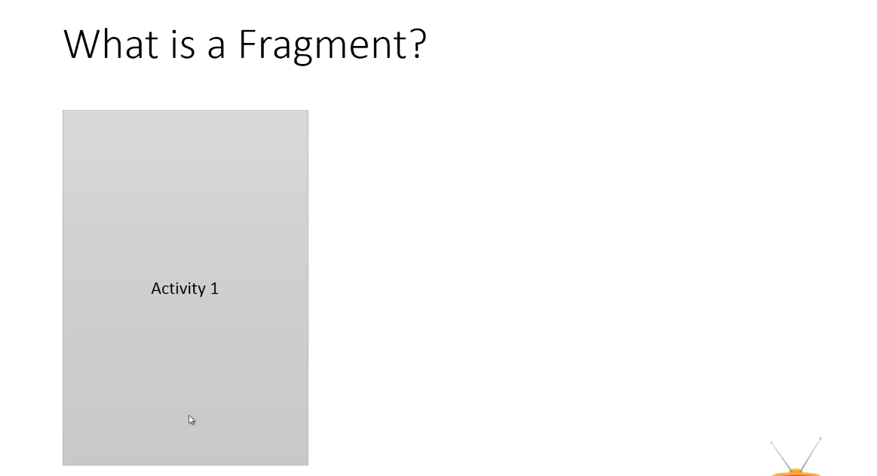
May & June 2012 Recruiting Plan
q
© 2014 Unbounded Solutions
6

Slide 7
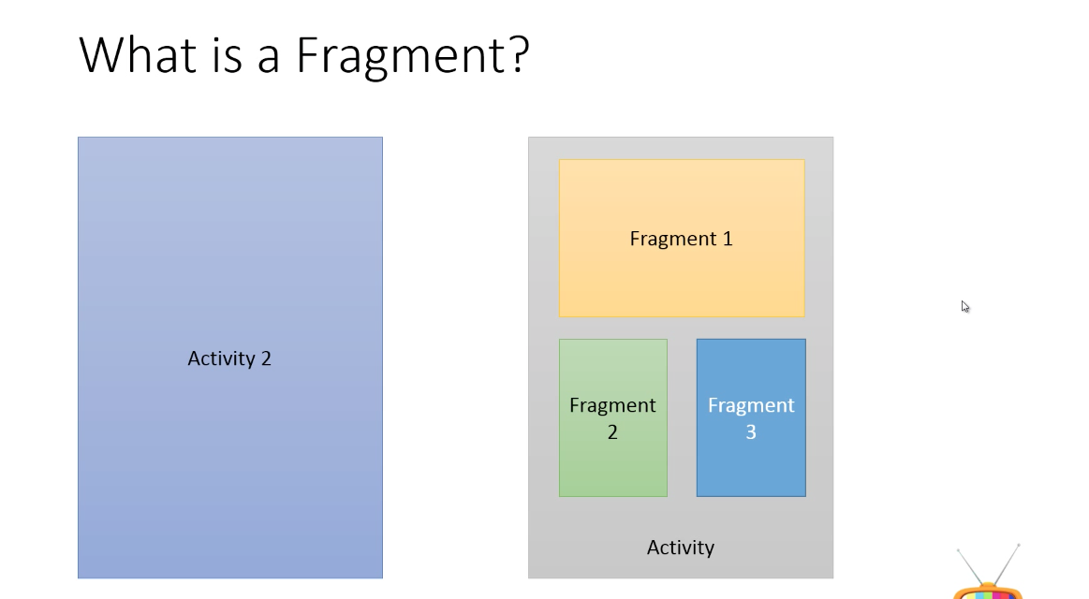
May & June 2012 Recruiting Plan
q
© 2014 Unbounded Solutions
7

Slide 8
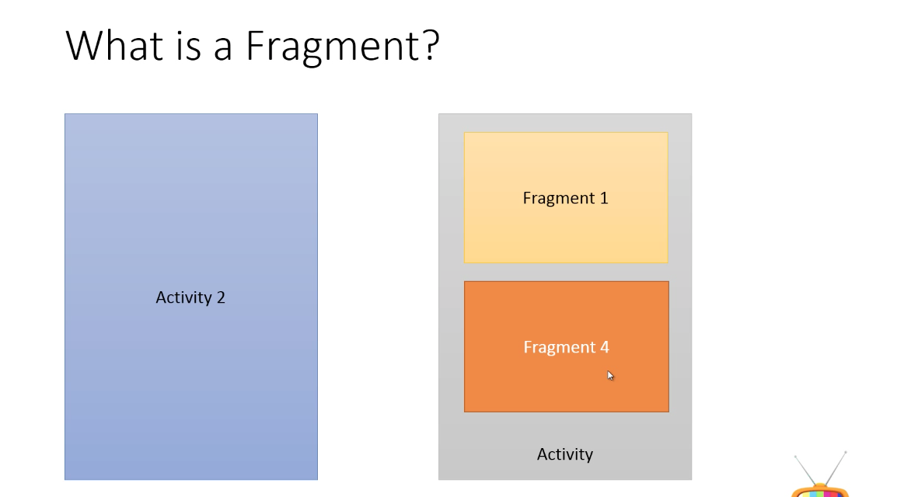
May & June 2012 Recruiting Plan
q
© 2014 Unbounded Solutions
8

Slide 9
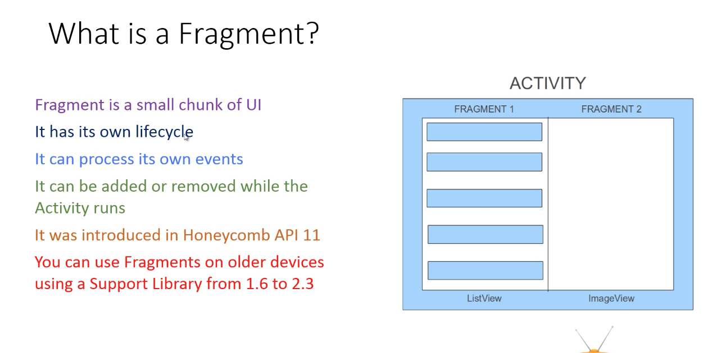
q
© 2014 Unbounded Solutions
9

Slide 10
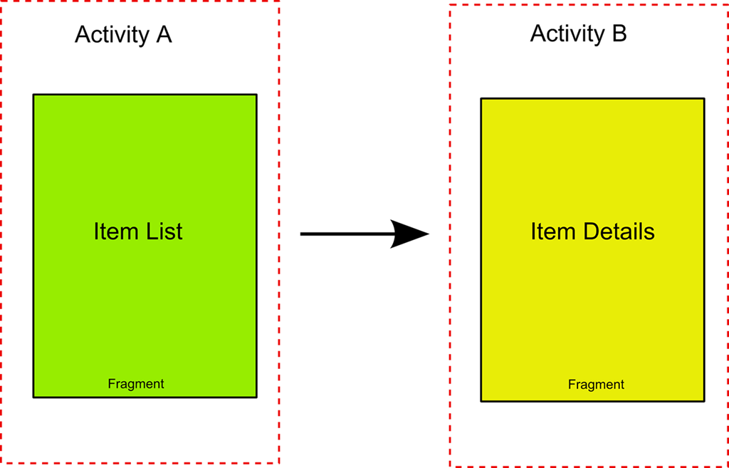
May & June 2012 Recruiting Plan
q
© 2014 Unbounded Solutions
10

Slide 11
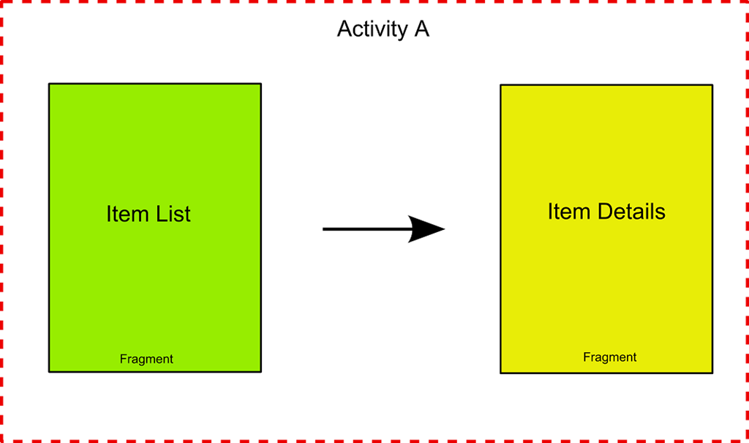
May & June 2012 Recruiting Plan
q
© 2014 Unbounded Solutions
11

Slide 12
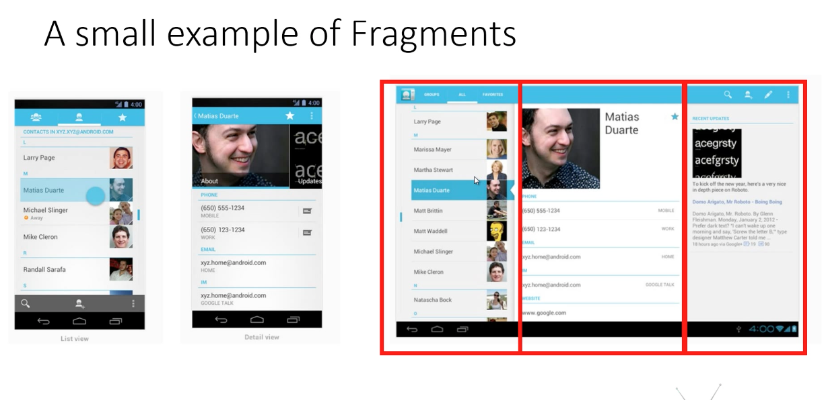
May & June 2012 Recruiting Plan
q
© 2014 Unbounded Solutions
12

Slide 13
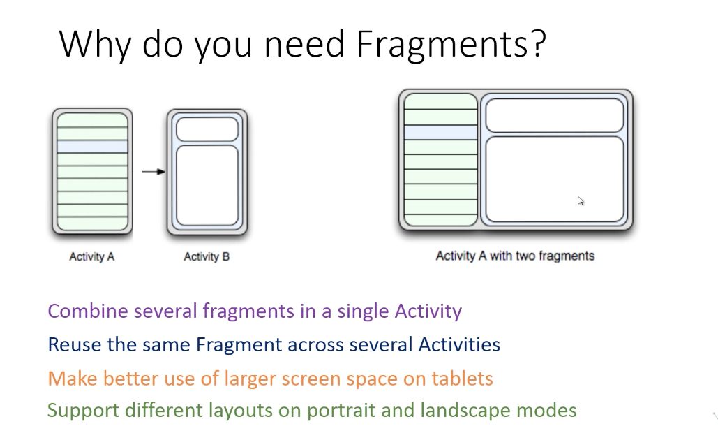
May & June 2012 Recruiting Plan
q
© 2014 Unbounded Solutions
13

Slide 14
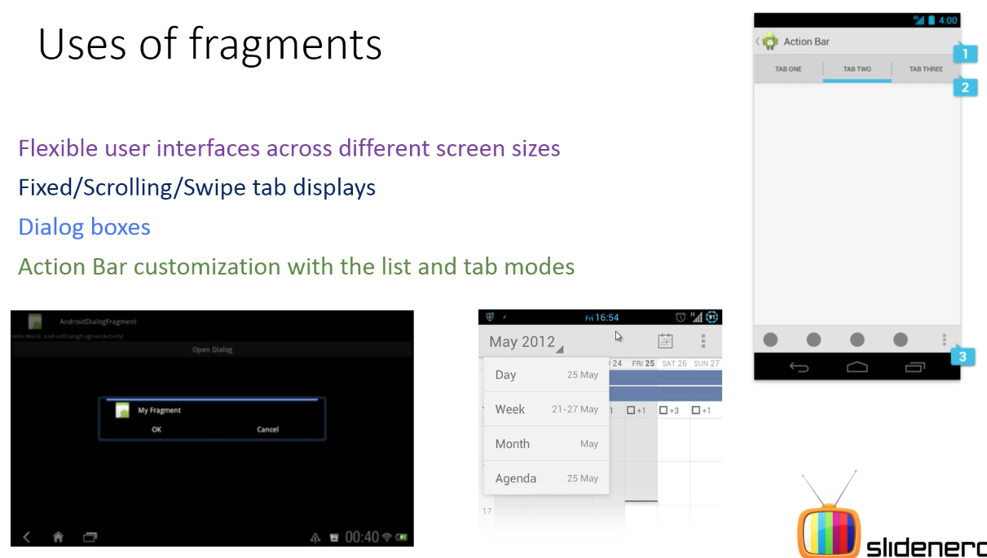
May & June 2012 Recruiting Plan
q
© 2014 Unbounded Solutions
14

Slide 15
Fragment Lifecycle

Slide 16
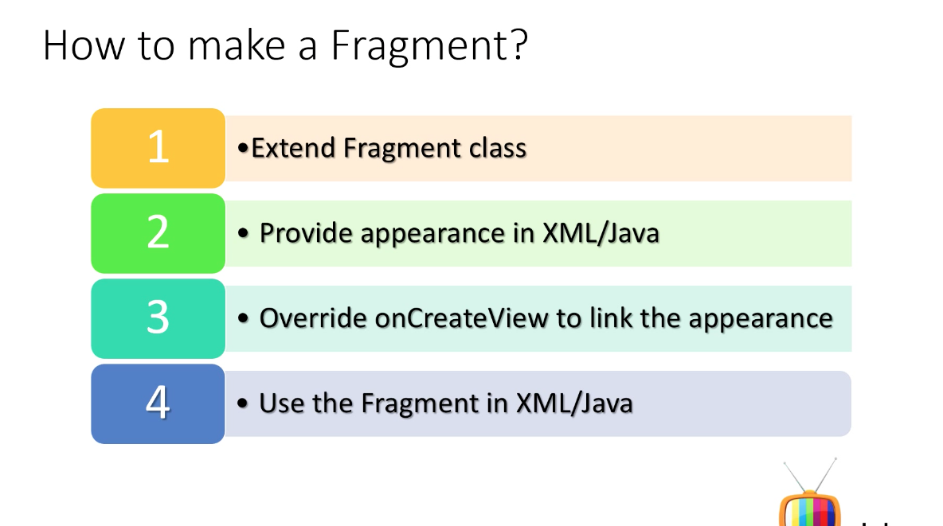
May & June 2012 Recruiting Plan
q
© 2014 Unbounded Solutions
16

Slide 17
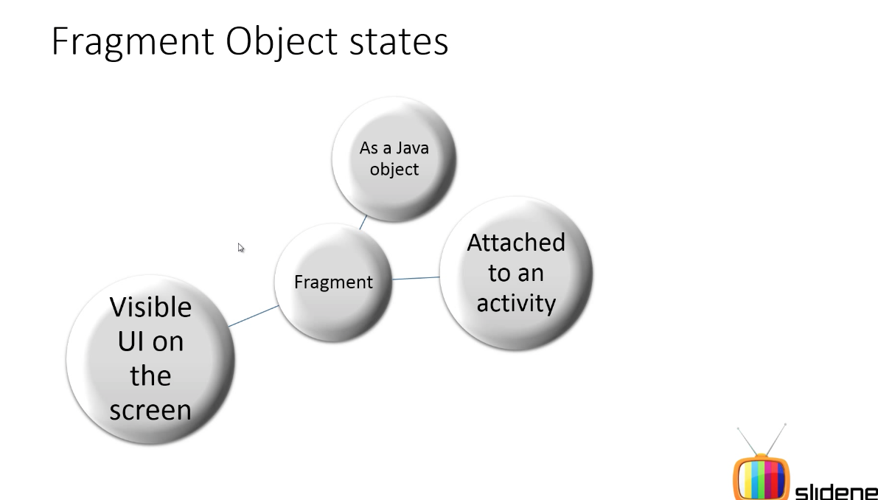
Output
May & June 2012 Recruiting Plan
q
© 2014 Unbounded Solutions
17

Slide 18
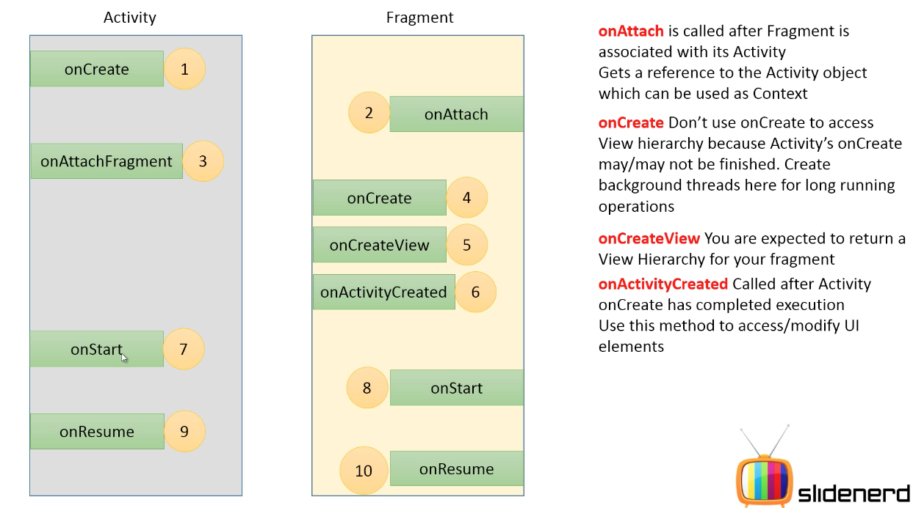
May & June 2012 Recruiting Plan
q
© 2014 Unbounded Solutions
18

Slide 19
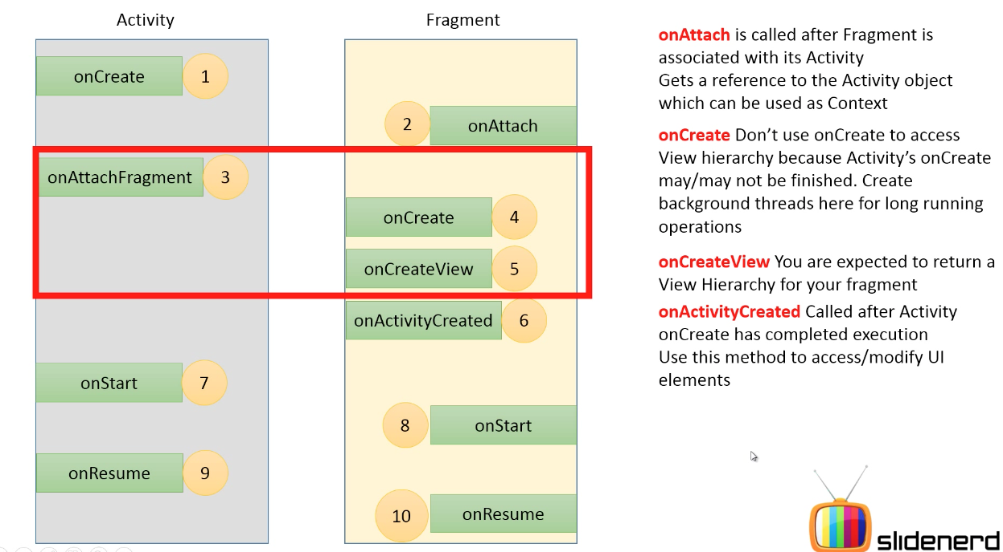
May & June 2012 Recruiting Plan
q
© 2014 Unbounded Solutions
19

Slide 20
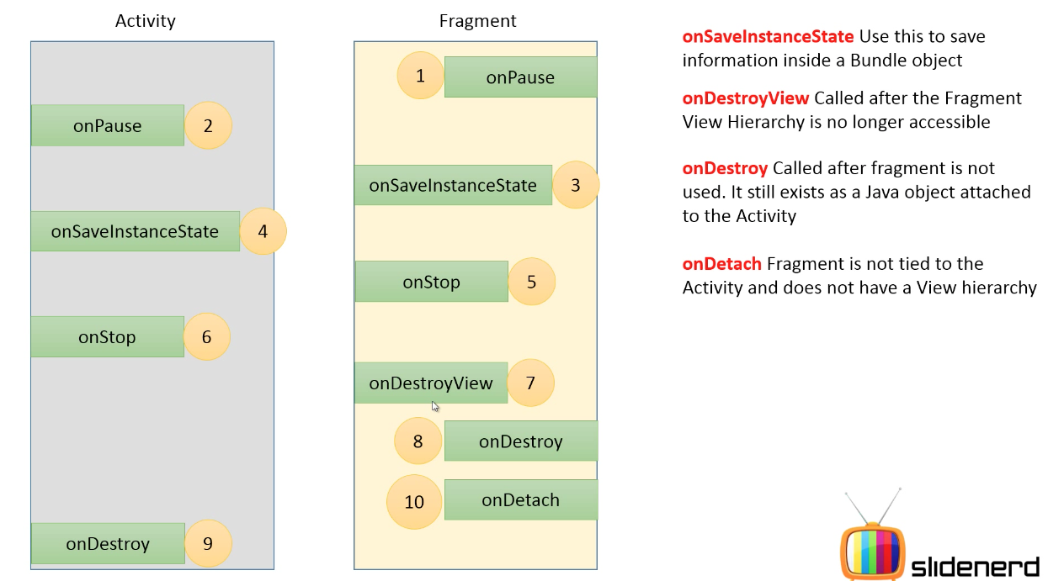
May & June 2012 Recruiting Plan
q
© 2014 Unbounded Solutions
20

Slide 21
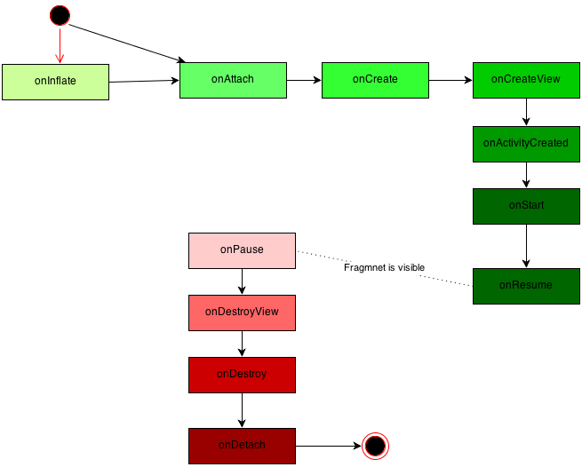
May & June 2012 Recruiting Plan
q
© 2014 Unbounded Solutions
21

Slide 22
OnInflate() Callback
May & June 2012 Recruiting Plan
If your fragment is defined by a<fragment> tag in a layout that is being inflated (typically when an activity has calledsetContentView() for its main layout), your fragment’s onInflate() callback is called.
At this stage in the fragment’s life, it’s too early to actually do anything with the user interface. The fragment is not evenassociated to its activity yet.
The expectation of onInflate() is that you’ll read attribute values and save them for later use.
Recruit 70 “Best Fit” Consulting Employees
Build out a Marketing team dedicated to recruiting
Formalize training program for new recruiters
Build out fully functioning offshore recruiting team
Implement call quality feedback loops
Coach and Mentor recruiters
Improve daily efficiency for recruiting team
© 2014 Unbounded Solutions
22

Slide 23
OnAttach() Callback
May & June 2012 Recruiting Plan
This method is called as soon as the fragment is “attached” to the “father” activity and we can this method to store the reference about the activity.
The onAttach() callback is invoked after your fragment is associated with its activity.
The activity reference is passed to you if you want to use it . You can at least use the activity to determine information about your enclosing activity.
You can also use the activity as a context to do other operations.
Recruit 70 “Best Fit” Consulting Employees
Build out a Marketing team dedicated to recruiting
Formalize training program for new recruiters
Build out fully functioning offshore recruiting team
Implement call quality feedback loops
Coach and Mentor recruiters
Improve daily efficiency for recruiting team
© 2014 Unbounded Solutions
23

Slide 24
NOTE
May & June 2012 Recruiting Plan
One thing to note is that the Fragment class has a getActivity() method that will always return the attached activity for your fragment should you need it.
Keep in mind that all during this lifecycle, the initialization arguments bundle is available to you from the fragment’s getArguments() method.
However, once the fragment is attached to its activity, you can’t call setArguments() again.
Recruit 70 “Best Fit” Consulting Employees
Build out a Marketing team dedicated to recruiting
Formalize training program for new recruiters
Build out fully functioning offshore recruiting team
Implement call quality feedback loops
Coach and Mentor recruiters
Improve daily efficiency for recruiting team
© 2014 Unbounded Solutions
24

Slide 25
OnCreate() Callback
May & June 2012 Recruiting Plan
Although this is similar to the activity’s onCreate() ,the difference is that you should not put code in here that relies on the existence of theactivity’s view hierarchy.
Your fragment may be associated to its activity by now, but you haven’t yet been notified that the activity’s onCreate() has finished.
This method can be used to start some thread to retrieve data information, maybe from a remote server.
Create a background thread to get data that this fragment will need. Your fragment code is running on the UI thread, and you don’t want to do disk
I/O or other technique.
Recruit 70 “Best Fit” Consulting Employees
Build out a Marketing team dedicated to recruiting
Formalize training program for new recruiters
Build out fully functioning offshore recruiting team
Implement call quality feedback loops
Coach and Mentor recruiters
Improve daily efficiency for recruiting team
© 2014 Unbounded Solutions
25

Slide 26
OnCreateView() Callback
May & June 2012 Recruiting Plan
From now on, our activity is active and created and we can use it when we need.
The expectation here is that you will return a view hierarchy for this fragment. The arguments passed in to this callback include a LayoutInflater, a ViewGroup parent (called container), and the saved bundle if one exists.
It is very important to note that you should not attach the view hierarchy to the ViewGroup parent passed in. That association will happen automatically later. You will very likely get exceptions if you attach the fragment’s view hierarchy to the parent in this callback.
Recruit 70 “Best Fit” Consulting Employees
Build out a Marketing team dedicated to recruiting
Formalize training program for new recruiters
Build out fully functioning offshore recruiting team
Implement call quality feedback loops
Coach and Mentor recruiters
Improve daily efficiency for recruiting team
© 2014 Unbounded Solutions
26

Slide 27
May & June 2012 Recruiting Plan
@Override
public View onCreateView(LayoutInflater inflater,
ViewGroup container, Bundle savedInstanceState) {
If(container == null)
return null;
View v = inflater.inflate(R.layout.details, container, false);
TextView text1 = (TextView) v.findViewById(R.id.text1);
text1.setText(myDataSet[ getPosition() ] );
return v;
}
Recruit 70 “Best Fit” Consulting Employees
Build out a Marketing team dedicated to recruiting
Formalize training program for new recruiters
Build out fully functioning offshore recruiting team
Implement call quality feedback loops
Coach and Mentor recruiters
Improve daily efficiency for recruiting team
© 2014 Unbounded Solutions
27

Slide 28
onActivityCreated() Callback
May & June 2012 Recruiting Plan
This is called after the activity has completed its onCreate() callback. You can now trust that the activity’s view hierarchy, including your own view hierarchy if you returned one earlier, is ready and available.
This is where you can do final tweaks to the user interface before the user sees it.
This could be especially important if this activity and its fragments are being re-created from a saved state.
It’s also where you can be sure that any other fragment for this activity has been attached to your activity.
Recruit 70 “Best Fit” Consulting Employees
Build out a Marketing team dedicated to recruiting
Formalize training program for new recruiters
Build out fully functioning offshore recruiting team
Implement call quality feedback loops
Coach and Mentor recruiters
Improve daily efficiency for recruiting team
© 2014 Unbounded Solutions
28

Slide 29
onStart() Callback
May & June 2012 Recruiting Plan
Now your fragment is visible to the user. But you haven’t started interacting with the user just yet. This callback is tied to the activity’s onStart() .
As such, whereas previously you may have put your logic into the activity’s onStart() , now you’re more likely to put your logic into the fragment’s onStart() , because that is also where the user interface components are.
Recruit 70 “Best Fit” Consulting Employees
Build out a Marketing team dedicated to recruiting
Formalize training program for new recruiters
Build out fully functioning offshore recruiting team
Implement call quality feedback loops
Coach and Mentor recruiters
Improve daily efficiency for recruiting team
© 2014 Unbounded Solutions
29

Slide 30
onResume() Callback
May & June 2012 Recruiting Plan
The last callback before the user can interact with your fragment is onResume() . This callback is tied to the activity’s onResume() .
When this callback returns, the user is free to interact with this fragment. For example, if you have a camera preview in your fragment, you would probably enable it in the fragment’s onResume().
So now you’ve reached the point where the app is busily making the user happy.
And then the user decides to get out of your app, either by Back’ing out, or by pressing the Home button.
Recruit 70 “Best Fit” Consulting Employees
Build out a Marketing team dedicated to recruiting
Formalize training program for new recruiters
Build out fully functioning offshore recruiting team
Implement call quality feedback loops
Coach and Mentor recruiters
Improve daily efficiency for recruiting team
© 2014 Unbounded Solutions
30

Slide 31
On App Close
May & June 2012 Recruiting Plan
Then it can happen that the activity is paused and so the activity’s onPause is called. Well onPause fragment method is called too.
After it it can happen that the OS decides to destroy our fragment view and so onDestroyView is called.
After it, if the system decides to dismiss our fragment it calls onDestroy method. Here we should release all the connection active and so on because our fragment is close to die. Even if it is during the destroy phase it is still attached to the father activity. The last step is detach the fragment from the activity and it happens when onDetach is called.
Recruit 70 “Best Fit” Consulting Employees
Build out a Marketing team dedicated to recruiting
Formalize training program for new recruiters
Build out fully functioning offshore recruiting team
Implement call quality feedback loops
Coach and Mentor recruiters
Improve daily efficiency for recruiting team
© 2014 Unbounded Solutions
31

Slide 32

Topic #1
May & June 2012 Recruiting Plan
Recruit 70 “Best Fit” Consulting Employees
Build out a Marketing team dedicated to recruiting
Formalize training program for new recruiters
Build out fully functioning offshore recruiting team
Implement call quality feedback loops
Coach and Mentor recruiters
Improve daily efficiency for recruiting team
Lifecycle of a Fragment
© 2014 Unbounded Solutions
32

Slide 33
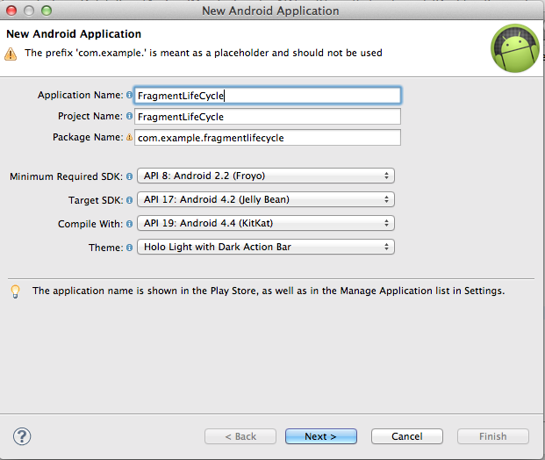
Create a New Project
May & June 2012 Recruiting Plan
q
© 2014 Unbounded Solutions
33

Slide 34
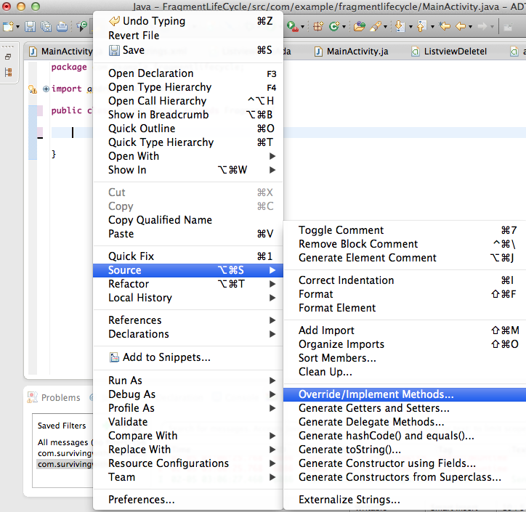
Add Methods
May & June 2012 Recruiting Plan
q
© 2014 Unbounded Solutions
34

Slide 35
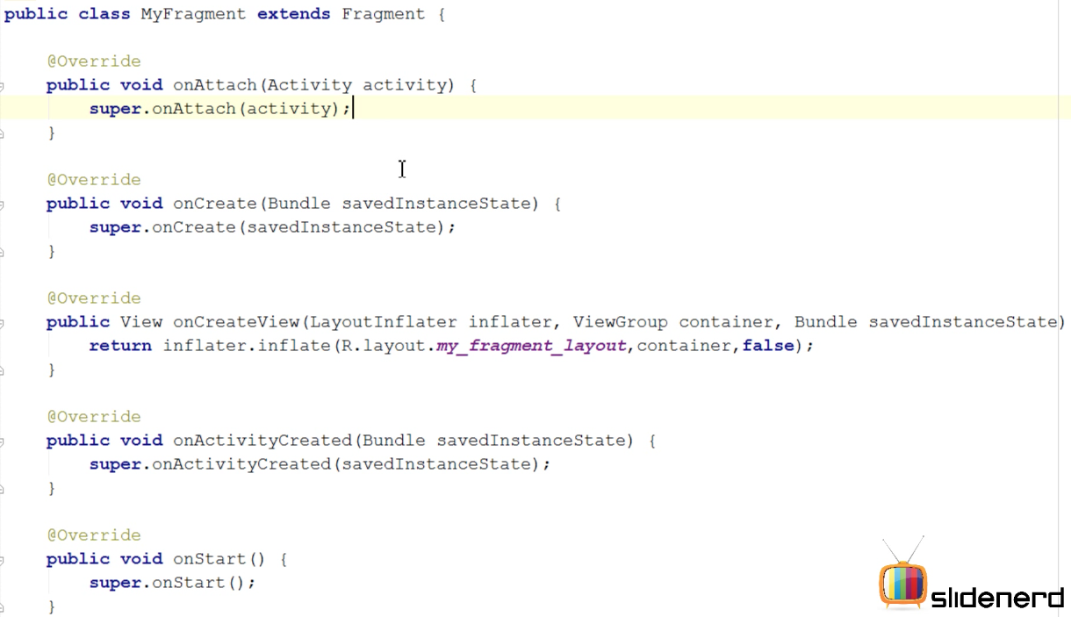
Output
May & June 2012 Recruiting Plan
q
© 2014 Unbounded Solutions
35

Slide 36
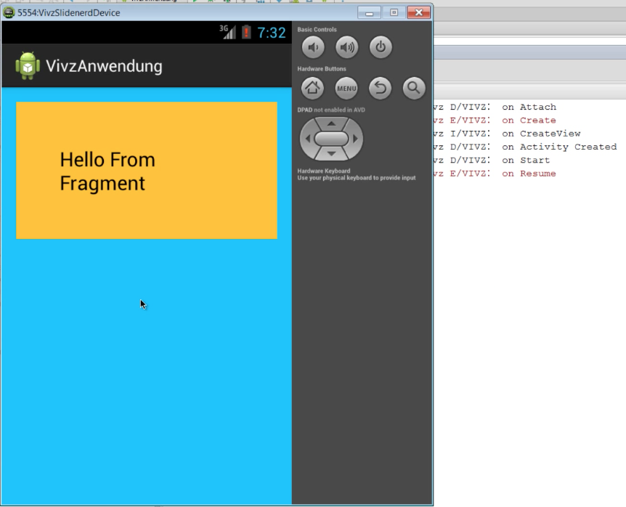
When App Starts
May & June 2012 Recruiting Plan
q
© 2014 Unbounded Solutions
36

Slide 37
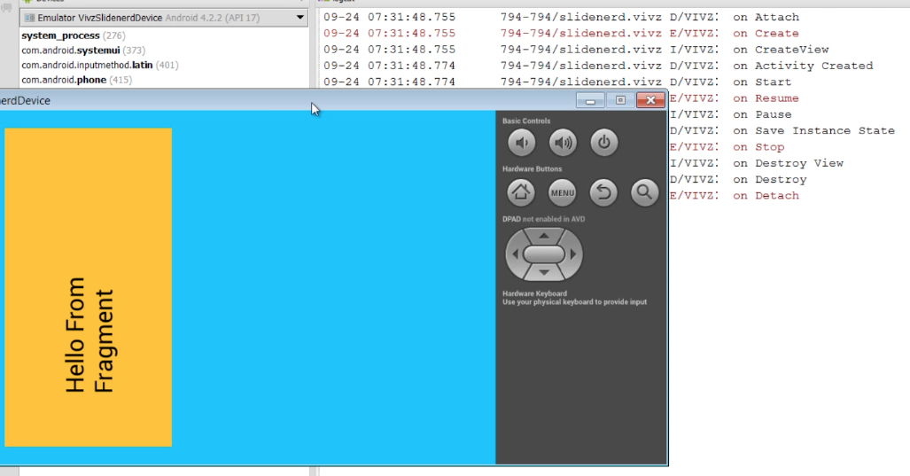
On Orientation Change
May & June 2012 Recruiting Plan
q
© 2014 Unbounded Solutions
37

Slide 38
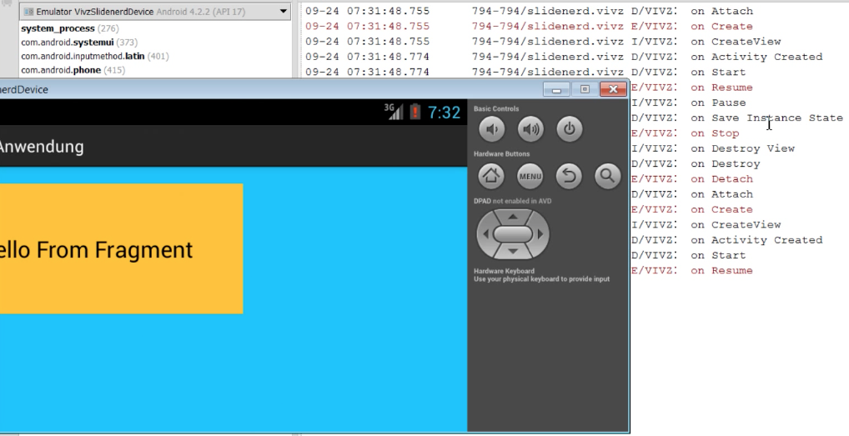
On Orientation Change App Resumes
May & June 2012 Recruiting Plan
q
© 2014 Unbounded Solutions
38

Slide 39
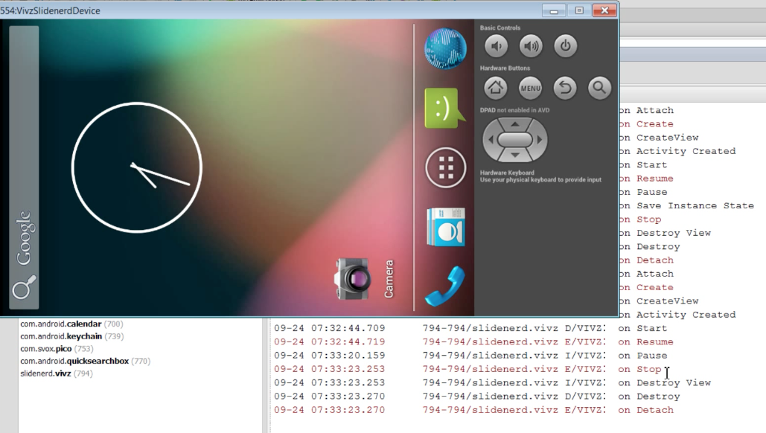
Back Key Pressed
May & June 2012 Recruiting Plan
q
© 2014 Unbounded Solutions
39

Slide 40
Adding Fragments in JAVA

Slide 41
Fragments: Implemented in Honeycomb (3.0) or Later
May & June 2012 Recruiting Plan
The primary classes related to fragments are:
android.app.Fragment
The base class for all fragment definitions
android.app.FragmentManager
The class for interacting with fragment objects inside an activity
android.app.FragmentTransaction
The class for performing an atomic set of fragment operations
Recruit 70 “Best Fit” Consulting Employees
Build out a Marketing team dedicated to recruiting
Formalize training program for new recruiters
Build out fully functioning offshore recruiting team
Implement call quality feedback loops
Coach and Mentor recruiters
Improve daily efficiency for recruiting team
© 2014 Unbounded Solutions
41

Slide 42
Fragments: Implemented in Donut (1.6) or Later
May & June 2012 Recruiting Plan
Google provides the Compatibility Package, a Java library that you can include in an application, implementing support for fragments and other Honeycomb features (loaders).
You can use the Compatibility Package with applications targeting 1.6 (API 4) or later.
For each of the classes in the Compatibility Package, the APIs work almost exactly the same as their counterparts in the latest Android platform.
Recruit 70 “Best Fit” Consulting Employees
Build out a Marketing team dedicated to recruiting
Formalize training program for new recruiters
Build out fully functioning offshore recruiting team
Implement call quality feedback loops
Coach and Mentor recruiters
Improve daily efficiency for recruiting team
© 2014 Unbounded Solutions
42

Slide 43
Fragments: Implemented in Donut (1.6) or Later
May & June 2012 Recruiting Plan
The primary classes related to fragments are:
android.support.v4.app.FragmentActivity
The base class for all activities using compatibility-based fragment (and loader) features
android.support.v4.app.Fragment
The base class for all fragment definitions
android.support.v4.app.FragmentManager
The class for interacting with fragment objects inside an activity
android.support.v4.app.FragmentTransaction
The class for performing an atomic set of fragment operations
Recruit 70 “Best Fit” Consulting Employees
Build out a Marketing team dedicated to recruiting
Formalize training program for new recruiters
Build out fully functioning offshore recruiting team
Implement call quality feedback loops
Coach and Mentor recruiters
Improve daily efficiency for recruiting team
© 2014 Unbounded Solutions
43

Slide 44
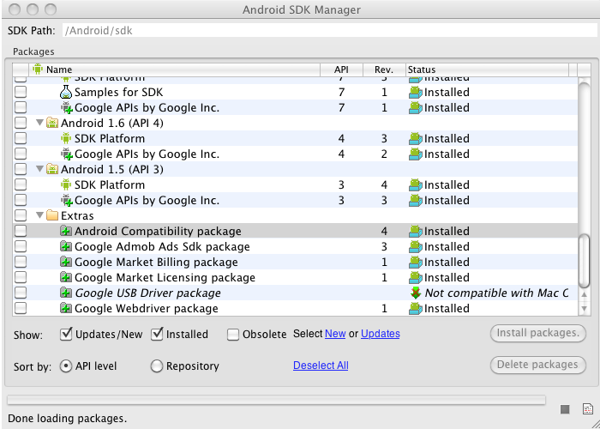
Fragments: Implemented in Donut (1.6) or Later
May & June 2012 Recruiting Plan
Recruit 70 “Best Fit” Consulting Employees
Build out a Marketing team dedicated to recruiting
Formalize training program for new recruiters
Build out fully functioning offshore recruiting team
Implement call quality feedback loops
Coach and Mentor recruiters
Improve daily efficiency for recruiting team
© 2014 Unbounded Solutions
44

Slide 45
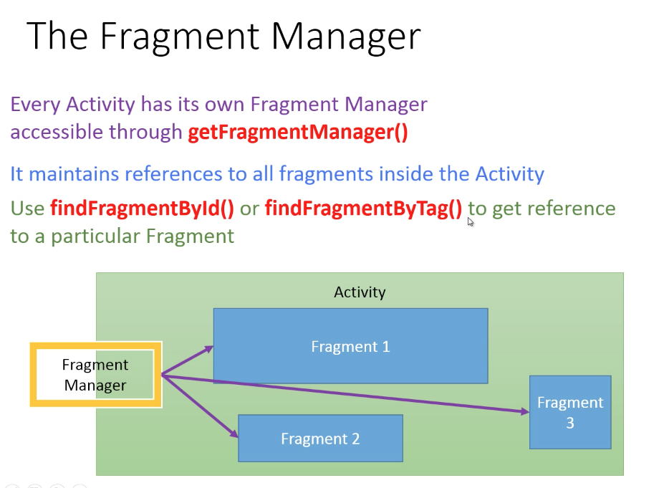
Explaination
May & June 2012 Recruiting Plan
q
© 2014 Unbounded Solutions
45

Slide 46
FragmentMaanager
May & June 2012 Recruiting Plan
A Fragment represents a portion of a user interface or an operation that runs within an Activity.
A single activity can contain multiple fragments and many fragments can be reused in many, different activities.
Although each fragment has each own lifecycle, it is connected with the Activity it belongs to, so it’s lifecycle is directly influenced by the activity’s lifecycle.
The main advantage of using fragments is due to the convenience of reusing the components in different layouts. In this tutorial, we are going to create our own fragments, where each one will be used when the user presses the appropriate button.
Recruit 70 “Best Fit” Consulting Employees
Build out a Marketing team dedicated to recruiting
Formalize training program for new recruiters
Build out fully functioning offshore recruiting team
Implement call quality feedback loops
Coach and Mentor recruiters
Improve daily efficiency for recruiting team
© 2014 Unbounded Solutions
46

Slide 47
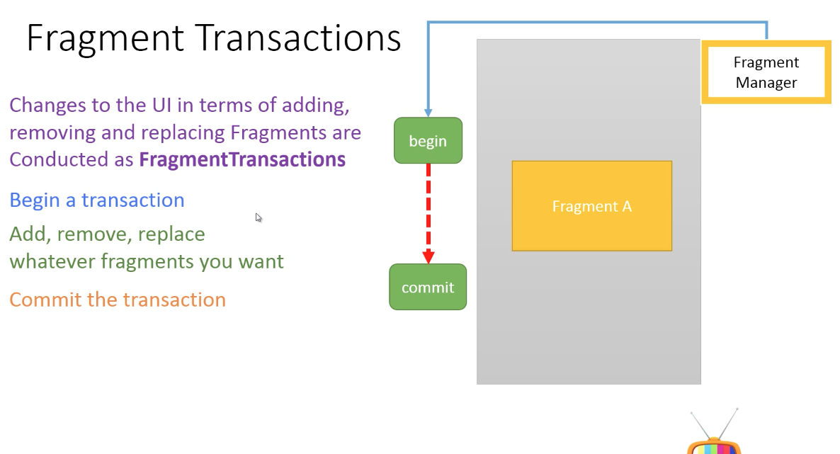
Output
May & June 2012 Recruiting Plan
q
© 2014 Unbounded Solutions
47

Slide 48
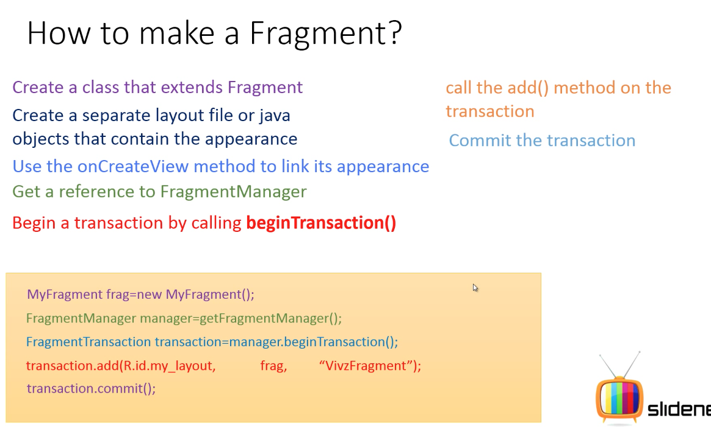
May & June 2012 Recruiting Plan
q
P1: Frag layout ID
P2: object
P3: ref used for findFragByRef()
© 2014 Unbounded Solutions
48

Slide 49
May & June 2012 Recruiting Plan
q
© 2014 Unbounded Solutions
49

Slide 50
Topic #2
May & June 2012 Recruiting Plan
Recruit 70 “Best Fit” Consulting Employees
Build out a Marketing team dedicated to recruiting
Formalize training program for new recruiters
Build out fully functioning offshore recruiting team
Implement call quality feedback loops
Coach and Mentor recruiters
Improve daily efficiency for recruiting team
Fragment Example
© 2014 Unbounded Solutions
50

Slide 51
Overview
May & June 2012 Recruiting Plan
A Fragment represents a portion of a user interface or an operation that runs within an Activity.
A single activity can contain multiple fragments and many fragments can be reused in many, different activities.
Although each fragment has each own lifecycle, it is connected with the Activity it belongs to, so it’s lifecycle is directly influenced by the activity’s lifecycle.
The main advantage of using fragments is due to the convenience of reusing the components in different layouts. In this tutorial, we are going to create our own fragments, where each one will be used when the user presses the appropriate button.
Recruit 70 “Best Fit” Consulting Employees
Build out a Marketing team dedicated to recruiting
Formalize training program for new recruiters
Build out fully functioning offshore recruiting team
Implement call quality feedback loops
Coach and Mentor recruiters
Improve daily efficiency for recruiting team
© 2014 Unbounded Solutions
51

Slide 52
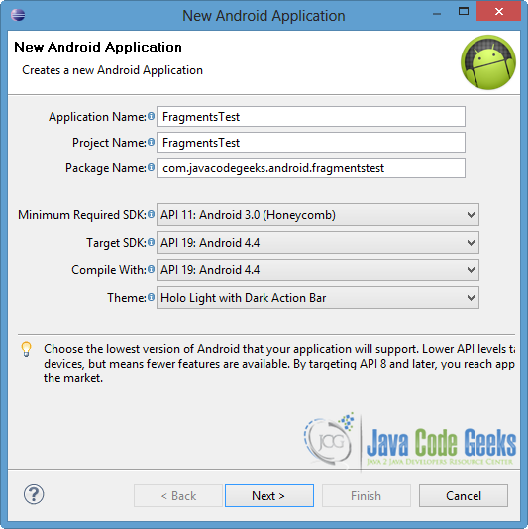
1#Create a New Android Application Project
May & June 2012 Recruiting Plan
q
© 2014 Unbounded Solutions
52

Slide 53
2#Create the layout of the Main Activity
May & June 2012 Recruiting Plan
q
For this example, we need two different Buttons.
When a button is pressed, a fragment appears below them.
So we will create two different buttons within the main LinearLayout and a fragment by using the <fragment> tag.
Open res/layout/activity_main.xml and go to the “activity_main.xml” tab.
© 2014 Unbounded Solutions
53

Slide 54
activity_main.xml
May & June 2012 Recruiting Plan
q
<LinearLayout xmlns:android="http://schemas.android.com/apk/res/android"
android:layout_width="match_parent"
android:layout_height="match_parent"
android:orientation="vertical" >
<Button
android:id="@+id/button1"
android:layout_width="fill_parent"
android:layout_height="wrap_content"
android:text="Fragment No.1"
android:onClick="selectFrag" />
<Button
android:id="@+id/button2"
android:layout_width="fill_parent"
android:layout_height="wrap_content"
android:onClick="selectFrag"
android:text="Fragment No.2" />
© 2014 Unbounded Solutions
54

Slide 55
activity_main.xml
May & June 2012 Recruiting Plan
q
<fragment
android:name="com.javacodegeeks.android.fragmentstest.FragmentOne"
android:id="@+id/fragment_place"
android:layout_width="match_parent"
android:layout_height="match_parent" />
</LinearLayout>
Please, notice the highlighted lines.
When we add a <fragment> element in a layout, we have to contain the android:name and android:id attributes.
The android:name defines an object of a Fragment Class, that we want to be instantiated and the android:id specifies the unique id of that fragment.
We will use the FragmentOne as default.
© 2014 Unbounded Solutions
55

Slide 56
4#Create the Fragments
May & June 2012 Recruiting Plan
q
We are going to make two different classes to define the fragments, that extends the Fragment Class.
Right click on com.javacodegeeks.android.filtertstest package → New → Class.
To the opened window, specify the name for the new Class.
We will name it FragmentOne and we will put it in the same package as the MainActivity.java file.
© 2014 Unbounded Solutions
56

Slide 57
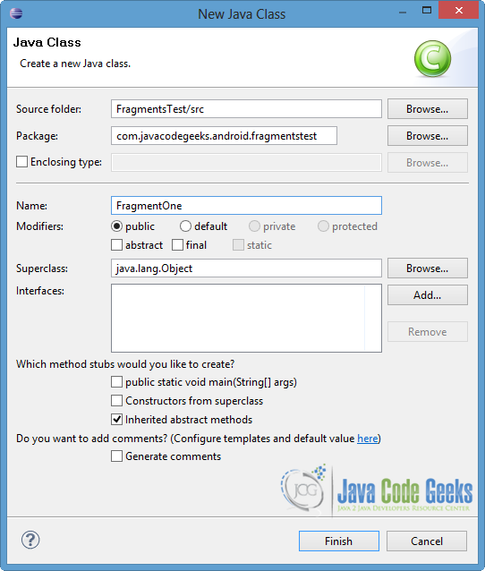
4#Create the Fragments
May & June 2012 Recruiting Plan
q
© 2014 Unbounded Solutions
57

Slide 58
Open src//FragmentOne.java
May & June 2012 Recruiting Plan
q
public class FragmentOne extends Fragment {
//STEP 1:EXTEND THE CLASS WITH FRAGMENT
//STEP 2:RIGHT CLICK->SOURCE->OVERRIDE_UNIMTD->ADD OnCreateView()
@Override
public View onCreateView(LayoutInflater inflater,
ViewGroup container, Bundle savedInstanceState) {
//Inflate the layout for this fragment
//STEP 3:BIND THE FRAMENT JAVA CLASS WITH XML
return inflater.inflate(
R.layout.fragment_one, container, false);
}
}
© 2014 Unbounded Solutions
58

Slide 59
5#Create the Second Fragment
May & June 2012 Recruiting Plan
q
With the same way, we create the second fragment.
Right click on com.javacodegeeks.android.filtertstest package → New → Class.
Specify the name for the new Class.
We will name it FragmentTwo and we will put it in the same package as the FragmentOne.java file.
© 2014 Unbounded Solutions
59

Slide 60
Open src//FragmentTwo.java
May & June 2012 Recruiting Plan
q
public class FragmentTwo extends Fragment{
//STEP 1:EXTEND THE CLASS WITH FRAGMENT
/STEP 2:RIGHT CLICK->SOURCE->OVERRIDE_UNIMTD->ADD OnCreateView()
@Override
public View onCreateView(LayoutInflater inflater,
ViewGroup container, Bundle savedInstanceState) {
/**
* Inflate the layout for this fragment
*/
//STEP 3:BIND THE FRAMENT JAVA CLASS WITH XML
return inflater.inflate(
R.layout.fragment_two, container, false);
}
© 2014 Unbounded Solutions
60

Slide 61
Explaination of Code
May & June 2012 Recruiting Plan
q
As you can see in the code above, we use the onCreateView override method.
It is called by the Android system so that the fragment creates it’s user interface.
Then, it returns a View component which is placed in the <fragment> element of the layout.
That’s the reason we use the inflate method, in order to inflate a layout of an xml file and to return it’s view.
© 2014 Unbounded Solutions
61

Slide 62
6#Create the layouts of the Fragments
May & June 2012 Recruiting Plan
q
We are going to make a simple UI for each fragment layout, so we are going to create two different xml files.
For FragmentOne we will create the fragment_one layout and for FragmentTwo the fragment_two respectively.
Right click on res/layout folder → New → Android XML File and name the xml file.
Choose the LinearLayout as root element, as shown in the picture below, and then press Finish.
© 2014 Unbounded Solutions
62

Slide 63
6#Create the layouts of the Fragments
May & June 2012 Recruiting Plan
q
© 2014 Unbounded Solutions
63

Slide 64
6#Open the res/layout/fragment_one.xml file
May & June 2012 Recruiting Plan
q
<LinearLayout
xmlns:android="http://schemas.android.com/apk/res/android"
android:layout_width="match_parent"
android:layout_height="match_parent"
android:orientation="vertical"
android:background="#00ffff">
<TextView
android:id="@+id/textView1"
android:layout_width="match_parent"
android:layout_height="match_parent"
android:layout_weight="1"
android:text="This is fragment No.1"
android:textStyle="bold" />
</LinearLayout>
© 2014 Unbounded Solutions
64

Slide 65
7#Open the res/layout/fragment_two.xml file
May & June 2012 Recruiting Plan
q
<LinearLayout
xmlns:android="http://schemas.android.com/apk/res/android"
android:layout_width="match_parent"
android:layout_height="match_parent"
android:orientation="vertical"
android:background="#ffff00">
<TextView
android:id="@+id/textView2"
android:layout_width="match_parent"
android:layout_height="match_parent"
android:text="This is fragment No.2"
android:textStyle="bold" />
</LinearLayout>
© 2014 Unbounded Solutions
65

Slide 66
7#Open the res/layout/fragment_two.xml file
May & June 2012 Recruiting Plan
q
In our example, we show the two buttons on the screen and when the appropriate button is pressed, the respective fragment is displayed.
By default, the layout of FragmentOne is shown, as we declared it in the activity_main.xml file at the android:name attribute of the <fragment> element.
© 2014 Unbounded Solutions
66

Slide 67
8#Update MainActivity.java
May & June 2012 Recruiting Plan
Method to handle OnClick()
q
public void selectFrag(View view) {
Fragment fr;
if(view == findViewById(R.id.button2)) {
fr = new FragmentTwo();
}else {
fr = new FragmentOne();
}
//STEPS : MTRC
FragmentManager fm = getFragmentManager();
FragmentTransaction fragmentTransaction = fm.beginTransaction();
fragmentTransaction.replace(R.id.fragment_place, fr);
fragmentTransaction.commit();
}
© 2014 Unbounded Solutions
67

Slide 68
Explaination
May & June 2012 Recruiting Plan
q
When our activity is running, we can add or replace fragments.
For this reason we use FragmentTransaction and we should make a commit after a change, in order to be effective.
In our example, we replace the fragment that is in use, with the one that the user “chooses” by pressing the appropriate button.
Notice that the containerViewId of replace method, is the unique id of the <fragment> element in the activity_main layout.
© 2014 Unbounded Solutions
68

Slide 69
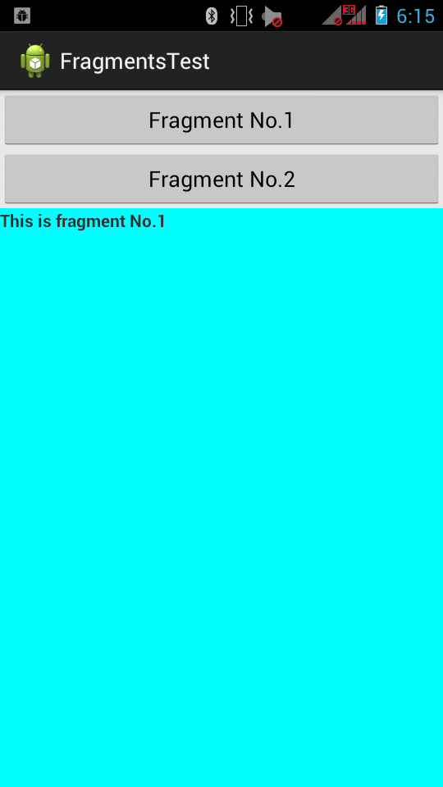
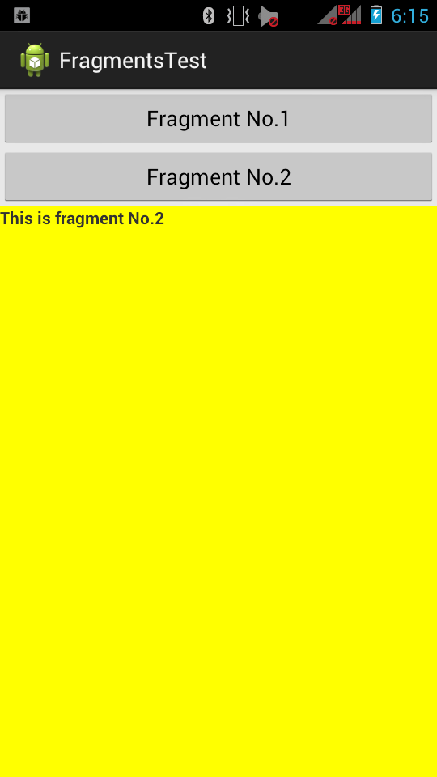
Output
May & June 2012 Recruiting Plan
q
© 2014 Unbounded Solutions
69

Slide 70
Fragment Backstack

Slide 71
Overview
May & June 2012 Recruiting Plan
As you know, activities are arranged in a stack, and as you get deeper and deeper into an application, it’s not uncommon to have a stack of several activities going at once.
When you press the Back button, the topmost activity goes away, and you are returned to the activity below, which resumes for you.
This can continue all the way down until you’re at the home screen again.
Recruit 70 “Best Fit” Consulting Employees
Build out a Marketing team dedicated to recruiting
Formalize training program for new recruiters
Build out fully functioning offshore recruiting team
Implement call quality feedback loops
Coach and Mentor recruiters
Improve daily efficiency for recruiting team
© 2014 Unbounded Solutions
71

Slide 72
Overview
May & June 2012 Recruiting Plan
When there are several fragments interacting with each other at the same time in an activity, and there’s a transition to new content across several fragments at once, pressing the Back button should cause each of the fragments to roll back one step together .
To ensure that each fragment properly participates in the rollback, a FragmentTransaction is created and managed to perform that coordination.
Recruit 70 “Best Fit” Consulting Employees
Build out a Marketing team dedicated to recruiting
Formalize training program for new recruiters
Build out fully functioning offshore recruiting team
Implement call quality feedback loops
Coach and Mentor recruiters
Improve daily efficiency for recruiting team
© 2014 Unbounded Solutions
72

Slide 73
Overview
May & June 2012 Recruiting Plan
Be aware that a back stack for fragments is not required within an activity.
You can code your application to let the Back button work at the activity level and not at the fragment level at all.
If there’s no back stack for your fragments, pressing the Back button will pop the current activity off the stack and return the user to whatever was underneath.
If youchoose to take advantage of the back stack for fragments
ft.addToBackStack("details")
Recruit 70 “Best Fit” Consulting Employees
Build out a Marketing team dedicated to recruiting
Formalize training program for new recruiters
Build out fully functioning offshore recruiting team
Implement call quality feedback loops
Coach and Mentor recruiters
Improve daily efficiency for recruiting team
© 2014 Unbounded Solutions
73

Slide 74
Fragment Animations

Slide 75
Overview
May & June 2012 Recruiting Plan
ft.setCustomAnimations(android.R.animator.fade_in, android.R.animator.fade_out);
The first parameter applies to the fragment entering, and the second parameter applies to the fragment exiting.
The other very important bit of knowledge you need is that the transition calls need to come before the replace() call; otherwise, they will have no effect.
Using the object animator for special effects on fragments can be a fun way to do transitions.
Recruit 70 “Best Fit” Consulting Employees
Build out a Marketing team dedicated to recruiting
Formalize training program for new recruiters
Build out fully functioning offshore recruiting team
Implement call quality feedback loops
Coach and Mentor recruiters
Improve daily efficiency for recruiting team
© 2014 Unbounded Solutions
75

Slide 76
Inter-Fragment Communication

Slide 77
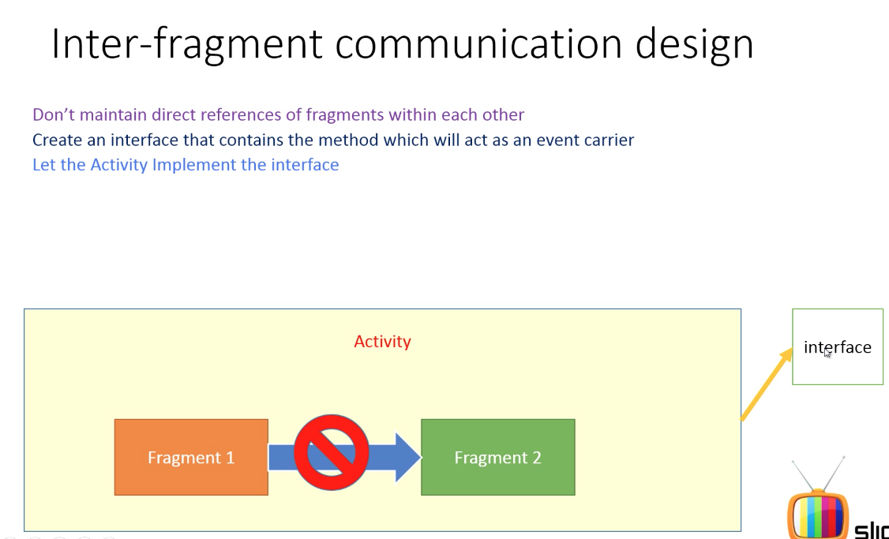
May & June 2012 Recruiting Plan
q
© 2014 Unbounded Solutions
77

Slide 78
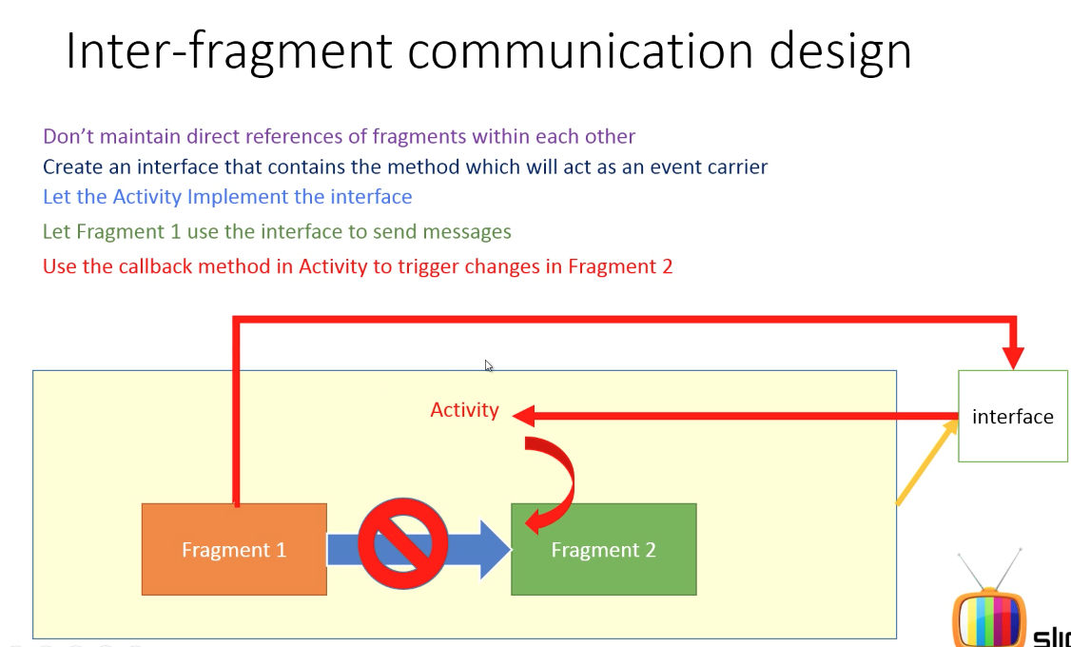
May & June 2012 Recruiting Plan
q
© 2014 Unbounded Solutions
78

Slide 79
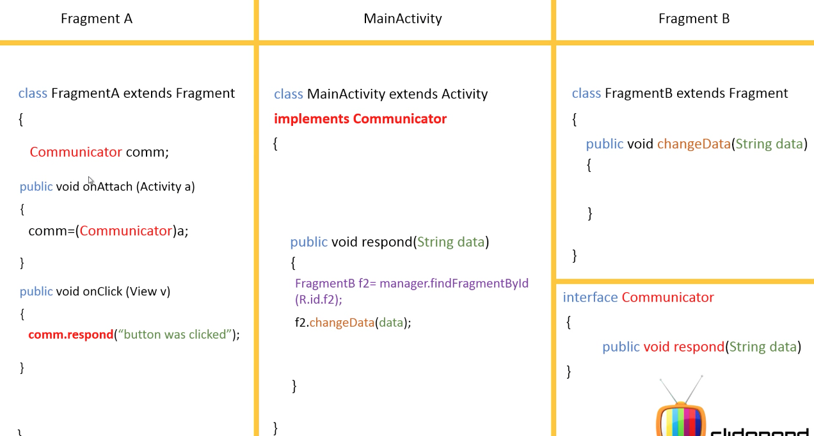
May & June 2012 Recruiting Plan
q
© 2014 Unbounded Solutions
79

Slide 80
May & June 2012 Recruiting Plan
q
4
2
5
6
3
8
7
1
© 2014 Unbounded Solutions
80

Slide 81
Best Practices: Loose Coupling of Activities and Fragments
May & June 2012 Recruiting Plan
Avoid tight coupling between activities and fragments.
Especially if you make the fragment “too aware” of its hosting activity and the other fragments that might (or might not) be present in the activity, you increase its complexity and reduce its reuse.
On the other hand, activities typical need more awareness of the fragments they and other activities host.
Rather than having a fragment directly access the internals of a hosting activity, create a nested interface within the fragment defining a set of callback methods.
Recruit 70 “Best Fit” Consulting Employees
Build out a Marketing team dedicated to recruiting
Formalize training program for new recruiters
Build out fully functioning offshore recruiting team
Implement call quality feedback loops
Coach and Mentor recruiters
Improve daily efficiency for recruiting team
© 2014 Unbounded Solutions
81

Slide 82
Topic #3
May & June 2012 Recruiting Plan
Recruit 70 “Best Fit” Consulting Employees
Build out a Marketing team dedicated to recruiting
Formalize training program for new recruiters
Build out fully functioning offshore recruiting team
Implement call quality feedback loops
Coach and Mentor recruiters
Improve daily efficiency for recruiting team
Fragment Communication
© 2014 Unbounded Solutions
82

Slide 83
Explaination
May & June 2012 Recruiting Plan
q
Create two fragments with layouts
Add a button to fragment1 and a textview to fragment2
Add the OnClick() to fragment 1 and change data to fragment2
to change the contents of the textview
Create an interface called Communicator with a single method in fragment1 , when user clicks the button ,fire the event with the communicator object.
In the activity where you can handle the communicator’s method find the fragment2 and call its changeData to modify the UI based on events received from fragment1.
© 2014 Unbounded Solutions
83

Slide 84
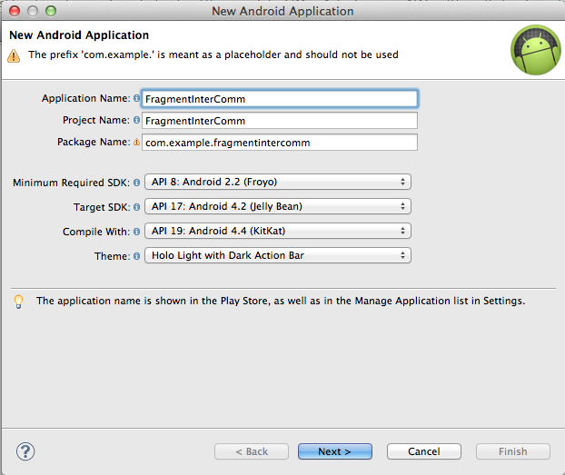
1#Create New App
May & June 2012 Recruiting Plan
q
© 2014 Unbounded Solutions
84

Slide 85
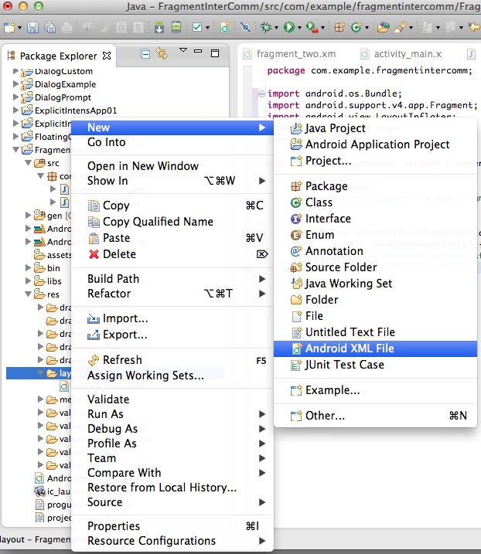
2#Create XML Design
May & June 2012 Recruiting Plan
<LinearLayout xmlns:android="http://schemas.android.com/apk/res/android"
android:layout_width="match_parent"
android:layout_height="match_parent"
android:orientation="vertical"
android:background="#FFBB00" >
<Button android:layout_width="wrap_content"
android:layout_height="wrap_content"
android:id="@+id/btn1"
android:text="Click Me">
</Button>
</LinearLayout>
q
© 2014 Unbounded Solutions
85

Slide 86
3#Create XML Design for Fragment_two
May & June 2012 Recruiting Plan
<LinearLayout xmlns:android="http://schemas.android.com/apk/res/android"
android:layout_width="match_parent"
android:layout_height="match_parent"
android:orientation="vertical"
android:background="#99CC00" >
<TextView
android:layout_width="match_parent"
android:layout_height="wrap_content"
android:id="@+id/tvDisplay"/>
</LinearLayout>
q
© 2014 Unbounded Solutions
86

Slide 87
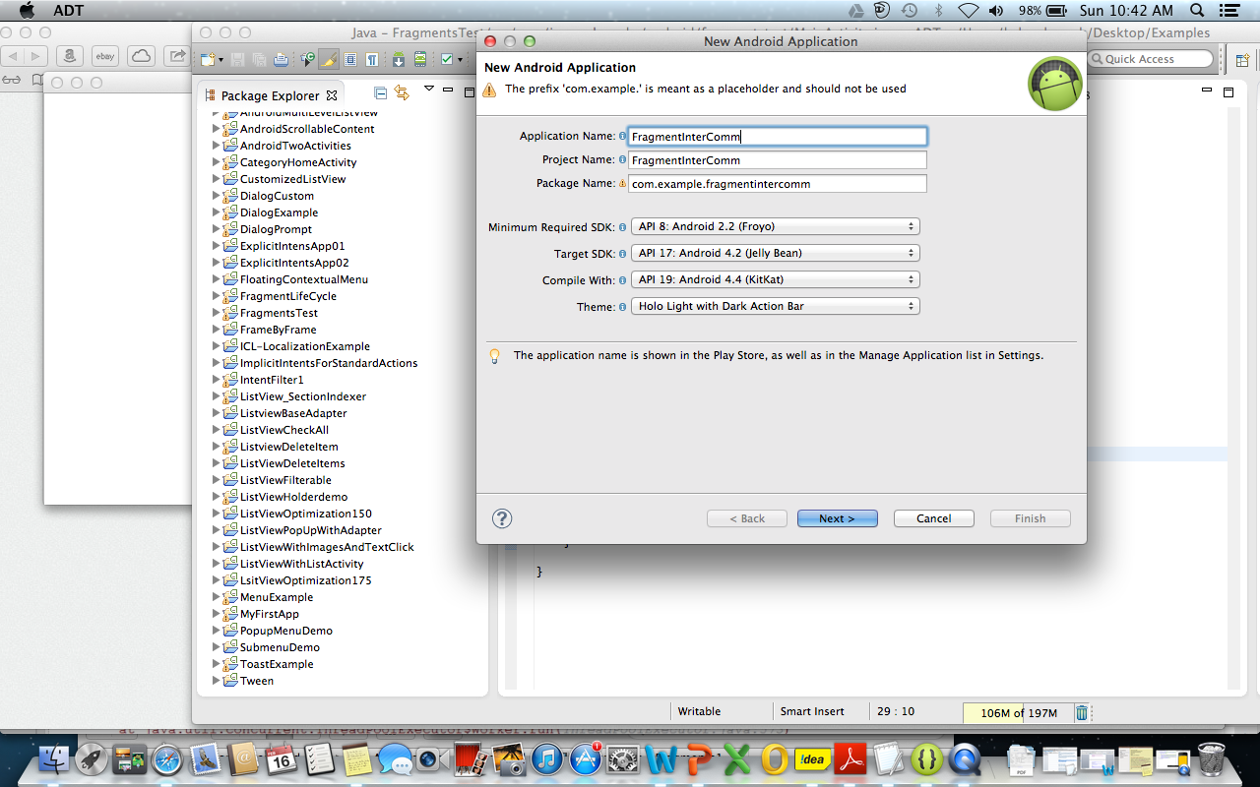
4#Create FragmentOne.java
May & June 2012 Recruiting Plan
q
© 2014 Unbounded Solutions
87

Slide 88
4#Update FragmentOne.java
May & June 2012 Recruiting Plan
q
public class FragmentOne extends Fragment {
//STEP 1:EXTEND THE CLASS WITH FRAGMENT
//STEP 2:RIGHT CLICK->SOURCE->OVERRIDE_UNIMTD->ADD OnCreateView()
@Override
public View onCreateView(LayoutInflater inflater,
ViewGroup container, Bundle savedInstanceState) {
//Inflate the layout for this fragment
//STEP 3:BIND THE FRAMENT JAVA CLASS WITH XML
return inflater.inflate(
R.layout.fragment_one, container, false);
}
}
© 2014 Unbounded Solutions
88

Slide 89
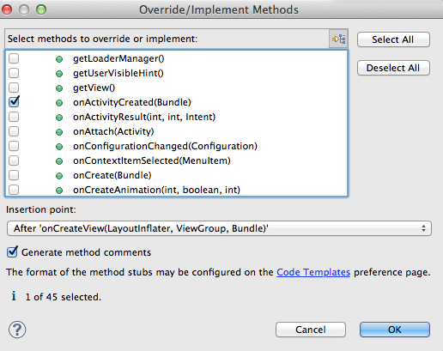
5#Add CallBack
May & June 2012 Recruiting Plan
q
© 2014 Unbounded Solutions
89

Slide 90
6#Initialize the UI
May & June 2012 Recruiting Plan
public class FragmentOne extends Fragment {
//STEP 1
Button btnClick;
int counter=0;
@Override
public View onCreateView(LayoutInflater inflater, ViewGroup container,
Bundle savedInstanceState) {
// TODO Auto-generated method stub
return inflater.inflate(R.layout.fragment_one, container,false);
}
@Override
public void onActivityCreated(Bundle savedInstanceState) {
// TODO Auto-generated method stub
super.onActivityCreated(savedInstanceState);
//STEP 2
btnClick=(Button) getActivity().findViewById(R.id.btn1);
btnClick.setOnClickListener(new View.OnClickListener() {
@Override
public void onClick(View arg0) {
counter++;
q
Create java objects for UI defined in XML
© 2014 Unbounded Solutions
90

Slide 91
7#Update FragmentTwo.java
May & June 2012 Recruiting Plan
q
public class FragmentTwo extends Fragment{
//STEP 1:EXTEND THE CLASS WITH FRAGMENT
/STEP 2:RIGHT CLICK->SOURCE->OVERRIDE_UNIMTD->ADD OnCreateView()
@Override
public View onCreateView(LayoutInflater inflater,
ViewGroup container, Bundle savedInstanceState) {
/**
* Inflate the layout for this fragment
*/
//STEP 3:BIND THE FRAMENT JAVA CLASS WITH XML
return inflater.inflate(
R.layout.fragment_two, container, false);
}
© 2014 Unbounded Solutions
91

Slide 92
8#Add CallBack
May & June 2012 Recruiting Plan
q
@Override
public void onActivityCreated(Bundle savedInstanceState) {
super.onActivityCreated(savedInstanceState);
tv=(TextView) getActivity().findViewById(R.id.tvDisplay);
}
//STEP 4:CREATE METHOD TO GET DATA FROM FRAGMENT2
public void ChangeData(String data){
tv.setText("The Value is"+ data);
}
© 2014 Unbounded Solutions
92

Slide 93
9#Add Fragment Layout to Activity
May & June 2012 Recruiting Plan
q
<RelativeLayout xmlns:android="http://schemas.android.com/apk/res/android"
xmlns:tools="http://schemas.android.com/tools"
android:layout_width="match_parent"
android:layout_height="match_parent"
tools:context=".MainActivity" >
<fragment
android:id="@+id/frag1"
android:name="com.example.fragmentintercomm.FragmentOne"
android:layout_width="match_parent"
android:layout_height="wrap_content" />
<fragment
android:id="@+id/frag2"
android:name="com.example.fragmentintercomm.FragmentTwo"
android:layout_width="match_parent"
android:layout_height="wrap_content" />
</RelativeLayout>
© 2014 Unbounded Solutions
93

Slide 94
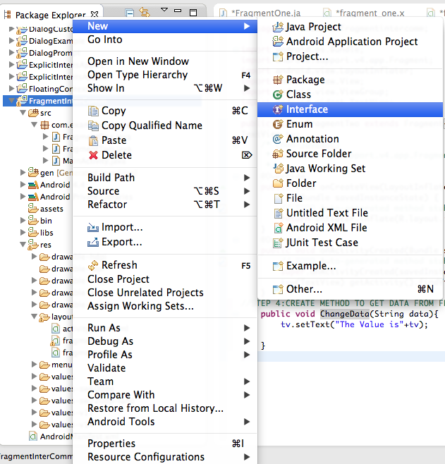
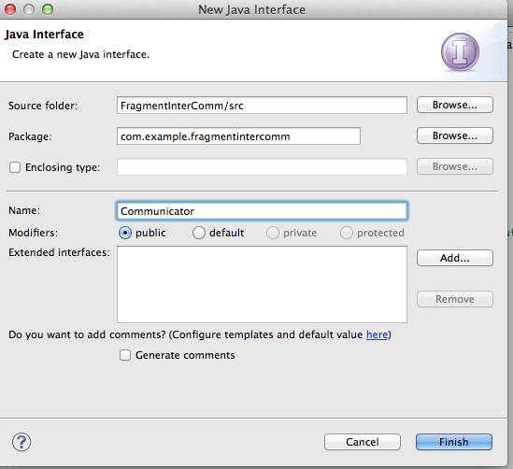
10#Create Interface File
May & June 2012 Recruiting Plan
q
© 2014 Unbounded Solutions
94

Slide 95
11#Create Interface Method
May & June 2012 Recruiting Plan
q
public interface Communicator {
public void respond(String data);
}
Interface Method between two fragments commumnication
© 2014 Unbounded Solutions
95

Slide 96
12#Main Activity Implements Interface
May & June 2012 Recruiting Plan
q
public class MainActivity extends Activity implements Communicator {
@Override
public void respond(String data) {
// TODO Auto-generated method stub
}
Override Unimplemeted Methods of Interface
© 2014 Unbounded Solutions
96

Slide 97
13#FragmentOne Communication
May & June 2012 Recruiting Plan
q
//STEP 1: ADD interface object
//Interface variable can refer a subclass object
//Dynamic Runtime Polymorphism
Communicator com;
//STEP 2: Reference to Main Activity
com=(Communicator) getActivity();
//STEP 3:Call Interface Methods
com.respond("The counter values is :"+counter);
© 2014 Unbounded Solutions
97

Slide 98
13#FragmentOne Communication
May & June 2012 Recruiting Plan
Communicator com;
@Override
public View onCreateView(LayoutInflater inflater, ViewGroup container,
Bundle savedInstanceState) {
// TODO Auto-generated method stub
return inflater.inflate(R.layout.fragment_one, container,false);
}
@Override
public void onActivityCreated(Bundle savedInstanceState) {
// TODO Auto-generated method stub
super.onActivityCreated(savedInstanceState);
btnClick=(Button) getActivity().findViewById(R.id.btn1);
//STEP 2: Reference to Main Activity
com=(Communicator) getActivity();
btnClick.setOnClickListener(new View.OnClickListener() {
@Override
public void onClick(View arg0) {
counter++;
//STEP 3:Call Interface Methods
com.respond("The counter values is :"+counter);
}
});
}
q
© 2014 Unbounded Solutions
98

Slide 99
13#Main Activity Implements Interface
May & June 2012 Recruiting Plan
q
public class MainActivity extends Activity implements Communicator {
@Override
public void respond(String data) {
FragmentManager fm=getFragmentManager();
FragmentTwo f2=(FragmentTwo)fm.findFragmentById(R.id.frag2);
f2.ChangeData(data);
}
Calls Method in Frag2
© 2014 Unbounded Solutions
99

Slide 100

Output
May & June 2012 Recruiting Plan
q
Fragment 1
Fragment 2
MainActivity
© 2014 Unbounded Solutions
100

Slide 101
A ListFragment Application

Slide 102
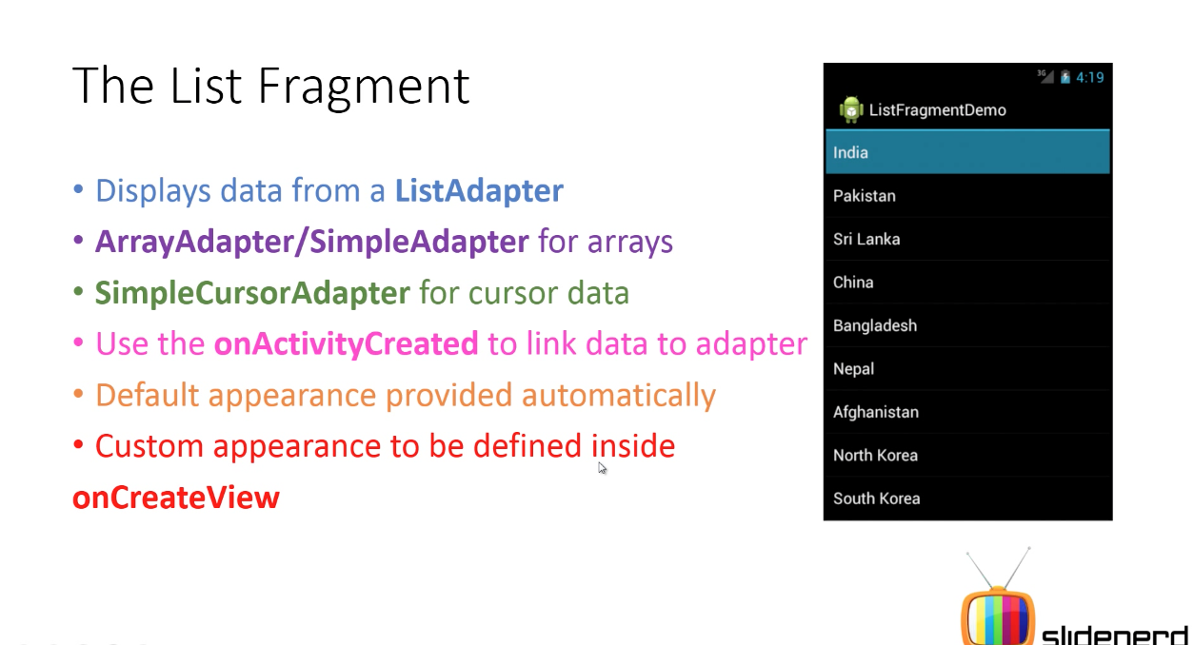
May & June 2012 Recruiting Plan
q
© 2014 Unbounded Solutions
102

Slide 103
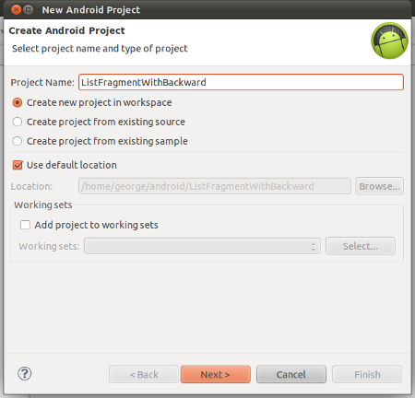
1#Create New App
May & June 2012 Recruiting Plan
q
© 2014 Unbounded Solutions
103

Slide 104
2#Extend ListFragment
May & June 2012 Recruiting Plan
q
public class CountryList extends ListFragment {
/**
* The list of countries to be shown in the ListFragment
*/
String[] countries = new String[] {
"India",
"Pakistan",
"Sri Lanka",
"China",
"Bangladesh",
"Nepal",
"Afghanistan",
"North Korea",
"South Korea",
"Japan"
};
© 2014 Unbounded Solutions
104

Slide 105
3#Overide OnCreateView
May & June 2012 Recruiting Plan
@Override
public View onCreateView(LayoutInflater inflater, ViewGroup container, Bundle savedInstanceState) {
/**
* Creating an array adapter to host the list of items to be displayed in the ListFragment
*/
ArrayAdapter<String> adapter = new ArrayAdapter<String>(
inflater.getContext(),
android.R.layout.simple_list_item_1,
countries);
setListAdapter(adapter);
return super.onCreateView(inflater, container, savedInstanceState);
}
q
© 2014 Unbounded Solutions
105

Slide 106
4#Initialize fragment in activity.xml
May & June 2012 Recruiting Plan
<?xml version="1.0" encoding="utf-8"?>
<LinearLayout xmlns:android="http://schemas.android.com/apk/res/android"
android:layout_width="fill_parent"
android:layout_height="fill_parent"
android:orientation="vertical" >
<fragment
android:tag="country_fragment”
android:name="in.wptrafficanalyzer.listfragmentwithbackward.CountryList"
android:layout_width="fill_parent"
android:layout_height="wrap_content"
/>
</LinearLayout>
q
© 2014 Unbounded Solutions
106

Slide 107
5#Main Activity
May & June 2012 Recruiting Plan
q
public class MainActivity extends FragmentActivity {
/** Called when the activity is first created. */
@Override
public void onCreate(Bundle savedInstanceState) {
super.onCreate(savedInstanceState);
setContentView(R.layout.main);
}
}
© 2014 Unbounded Solutions
107

Slide 108
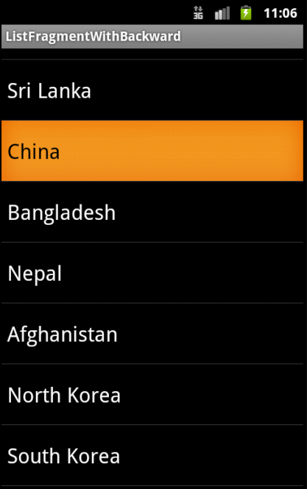
3#Overide OnCreateView
May & June 2012 Recruiting Plan
q
© 2014 Unbounded Solutions
108

Slide 109
Practical#2
May & June 2012 Recruiting Plan
q
© 2014 Unbounded Solutions
109

Slide 110
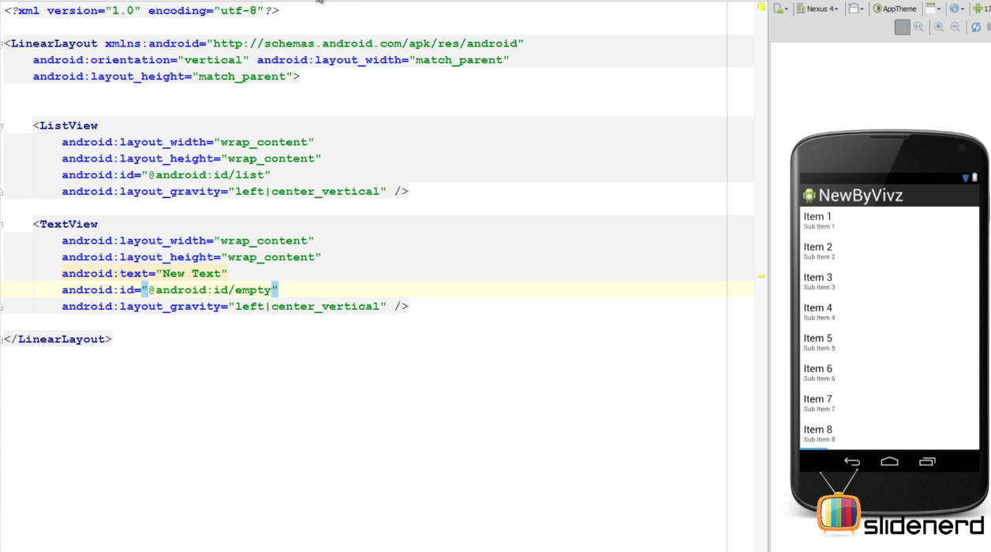
Fragment XML
May & June 2012 Recruiting Plan
q
© 2014 Unbounded Solutions
110

Slide 111
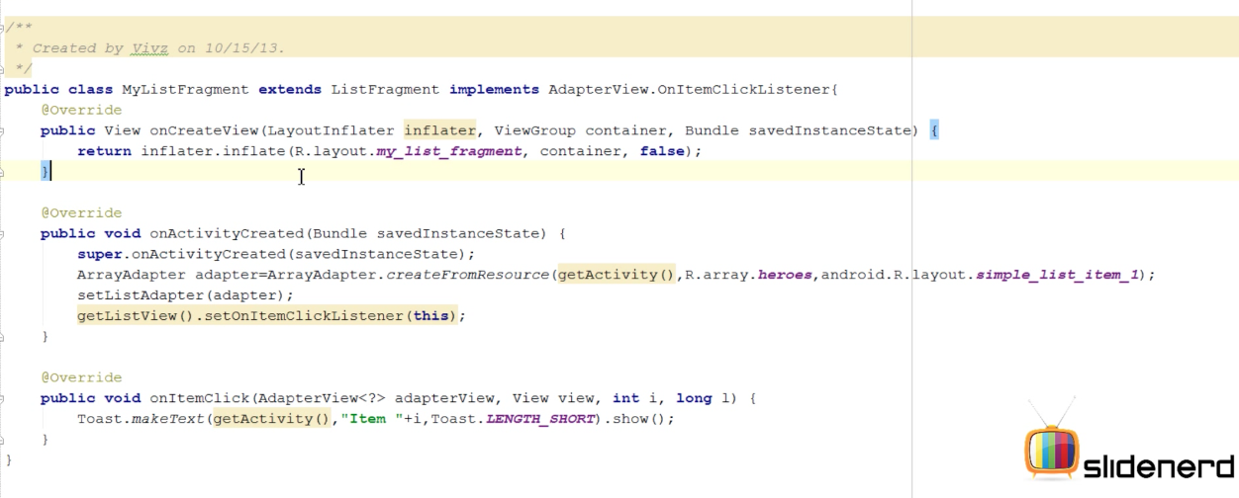
Fragment Java
May & June 2012 Recruiting Plan
q
© 2014 Unbounded Solutions
111

Slide 112
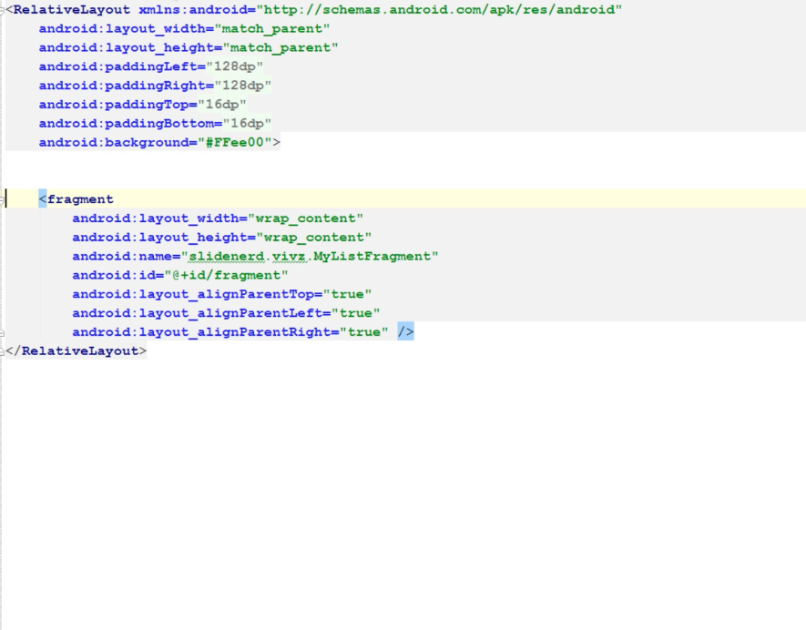
Main.xml(Register the fragment)
May & June 2012 Recruiting Plan
q
© 2014 Unbounded Solutions
112

Slide 113
3#Overide OnCreateView
May & June 2012 Recruiting Plan
q
© 2014 Unbounded Solutions
113

Slide 114
Dialog Fragments

Slide 115
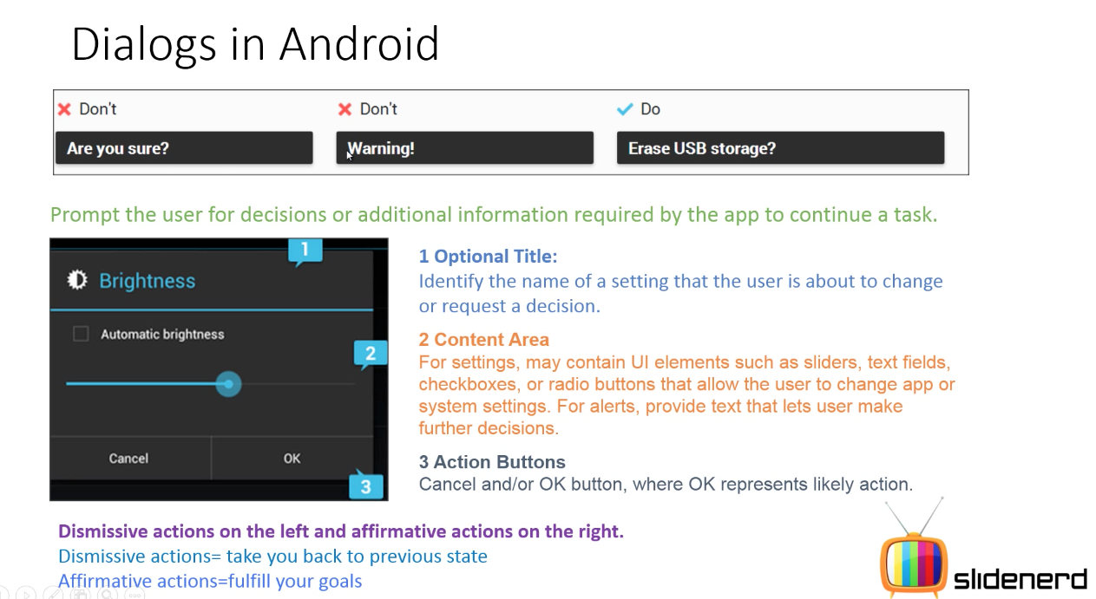
May & June 2012 Recruiting Plan
q
© 2014 Unbounded Solutions
115

Slide 116
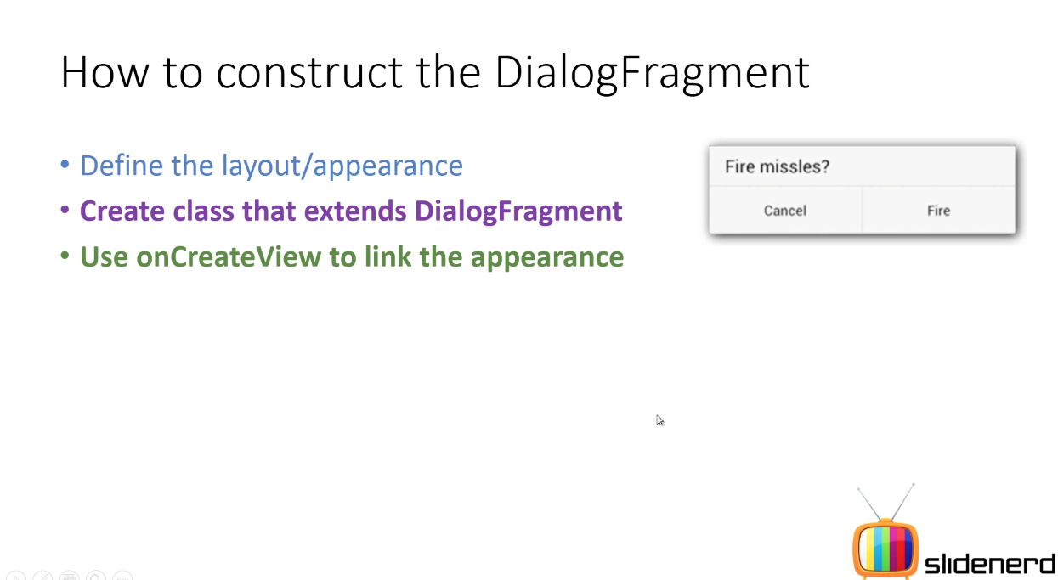
May & June 2012 Recruiting Plan
q
© 2014 Unbounded Solutions
116

Slide 117
References
CodePath :
http://guides.codepath.com/android#networking-and-models
Detail Example :
http://wptrafficanalyzer.in/blog/android-fragment-application-series/

Slide 118
Interview Questions
What is the parent class of Fragment ?
How is a fragment like an activity?
How is a fragment different from an activity?
What is a back stack used for?
Can you have an application that does not use a back stack?
True or false: rolling back a FragmentTransaction restores an applicationto its prior state.
What are the steps to add fragments dynamically?

Slide 119
Conti…
How does a <fragment> tag specify which fragment to use?
Do you attach the data adapter to the ListFragment , or to the ListView within the ListFragment ?
What are the different ways to find an existing fragment running in your Application?
What is an interpolator, and what is it used for?
List some of the view dimensions on which you can use an animator.

Slide 120
EXERCISE

